Slide 1
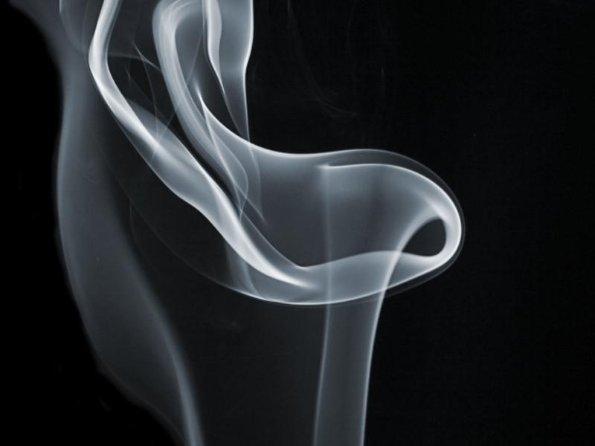
Target Driven Smoke Simulation
By Yanjie Feng and Shijing Liu

Slide 2




Slide 3
Goal
Provide Smoke Simulation that can be driven by any images
Port data to maya for better rendering

Slide 4
Approach
Add driven force term to induce the fluid flow to the current density towards specified density target
Add a gathering term to counteract diffusion of smoke

Slide 5
Details
Start Code is our Macgrid Smoke Simulation
We will add driven force, attenuate momentum and gather smoke terms.
The paper we use is Target Driven Smoke Animation by Raanan Fattal and Dani Lischinski

Slide 6
Stages

Slide 7
Result

